Slide 1
COT5615: Math for Intelligent Systems I
Anand Rangarajan
Lecture 32

Slide 2
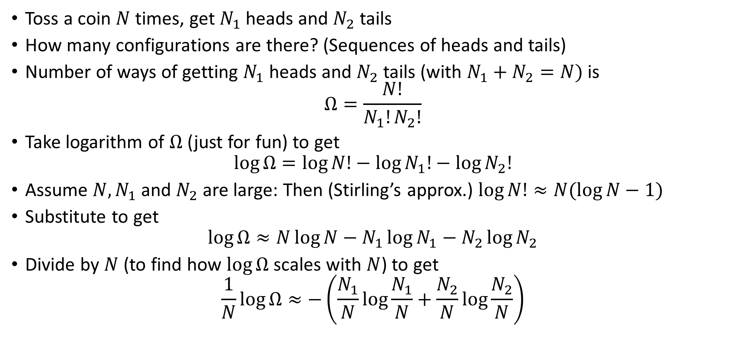
Configurations of Coin Tosses
Toss a coin $N$ times, get $N_{1}$ heads and $N_{2}$ tails
How many configurations are there? (Sequences of heads and tails)
Number of ways of getting $N_{1}$ heads and $N_{2}$ tails (with $N_{1}+N_{2}=N)$ is
$$Ω=\frac{N!}{N_{1}!N_{2}!}$$
Take logarithm of $Ω$ (just for fun) to get
$$\log{Ω=\log{N!}−\log{N_{1}!}−\log{N_{2}!}}$$
Assume $N, N_{1}$ and $N_{2}$ are large: Then (Stirling’s approx.) $\log{N!}≈N(\log{N}−1)$
Substitute to get
$$\log{Ω}≈N\log{N}−N_{1}\log{N_{1}}−N_{2}\log{N_{2}}$$
Divide by $N$ (to find how $\log{Ω}$ scales with $N$) to get
$$\frac{1}{N}\log{Ω}≈−\left(\frac{N_{1}}{N}\log{\frac{N_{1}}{N}}+\frac{N_{2}}{N}\log{\frac{N_{2}}{N}}\right)$$

Slide 3
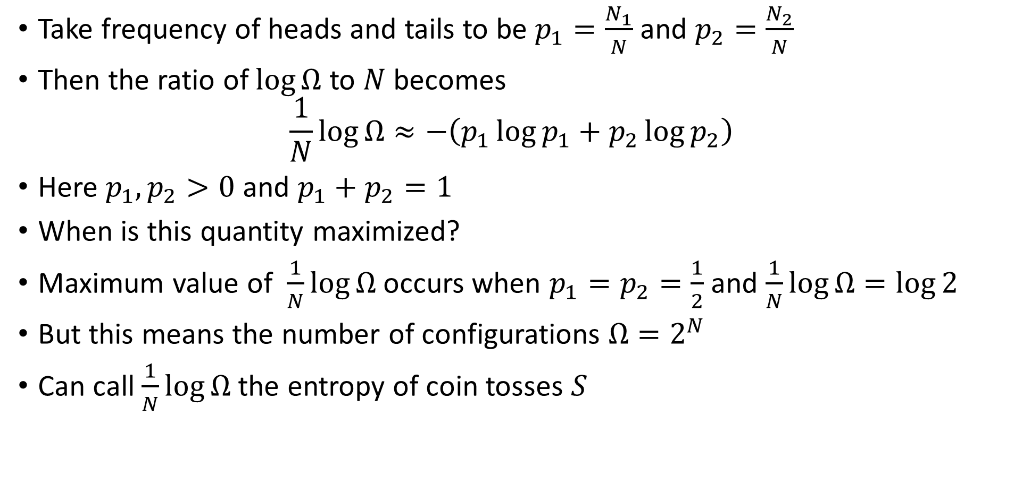
“Probabilities” of Heads and Tails and Entropy
Take frequency of heads and tails to be $p_{1}=\frac{N_{1}}{N}$ and $p_{2}=\frac{N_{2}}{N}$
Then the ratio of $\log{Ω}$ to $N$ becomes
$$\frac{1}{N}\log{Ω}≈−\left(p_{1}\log{p_{1}}+p_{2}\log{p_{2}}\right)$$
Here $p_{1},p_{2}>0$ and $p_{1}+p_{2}=1$
When is this quantity maximized?
Maximum value of $\frac{1}{N}\log{Ω}$ occurs when $p_{1}=p_{2}=\frac{1}{2}$ and $\frac{1}{N}\log{Ω}=\log{2}$
But this means the number of configurations $Ω=2^{N}$
Can call $\frac{1}{N}\log{Ω}$ the entropy of coin tosses $S$

Slide 4
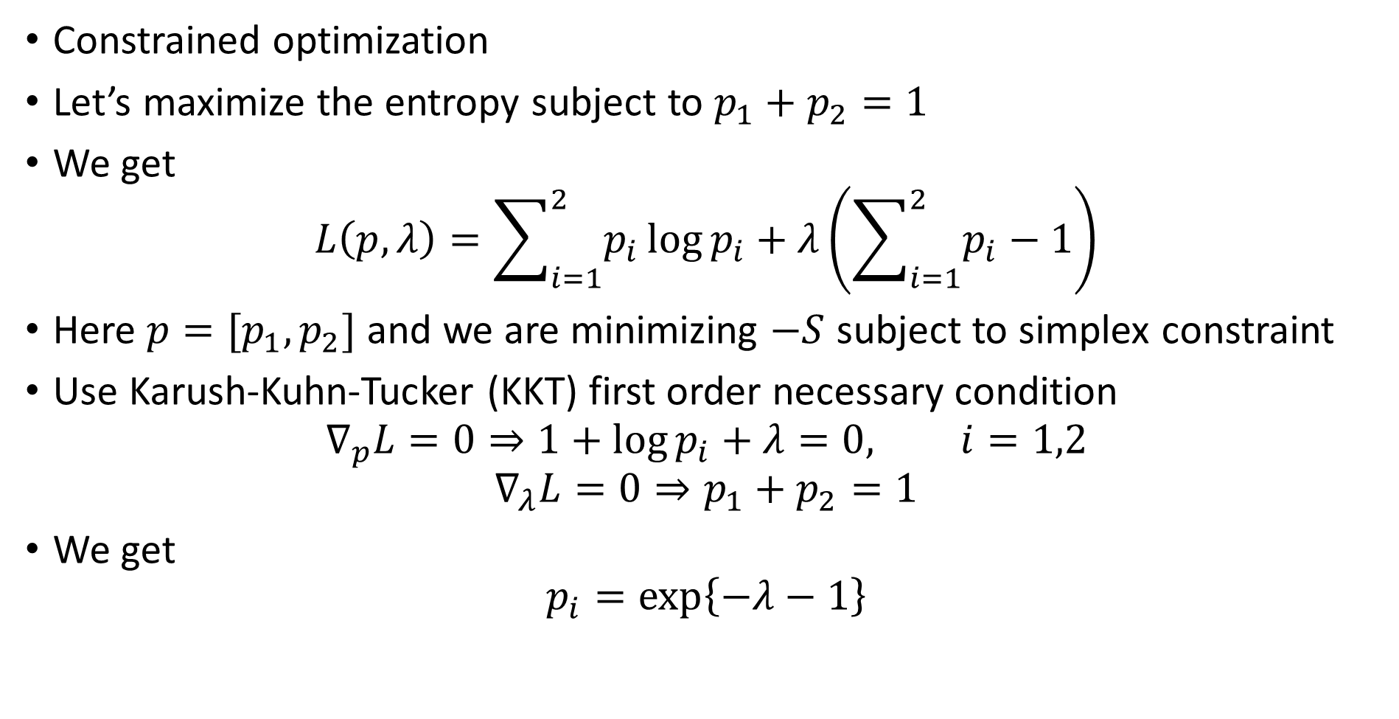
Maximizing the Entropy
Constrained optimization
Let’s maximize the entropy subject to $p_{1}+p_{2}=1$
We get
$$L\left(p,λ\right)=\sum_{i=1}^{2}{p_{i}\log{p_{i}}}+λ\left(\sum_{i=1}^{2}{p_{i}}−1\right)$$
Here $p=[p_{1},p_{2}]$ and we are minimizing $−S$ subject to simplex constraint
Use Karush-Kuhn-Tucker (KKT) first order necessary condition
$$∇_{p}L=0⇒1+\log{p_{i}}+λ=0, i=1,2$$
$$∇_{λ}L=0⇒p_{1}+p_{2}=1$$
We get
$$p_{i}=\exp\left\{−λ−1\right\}$$

Slide 5
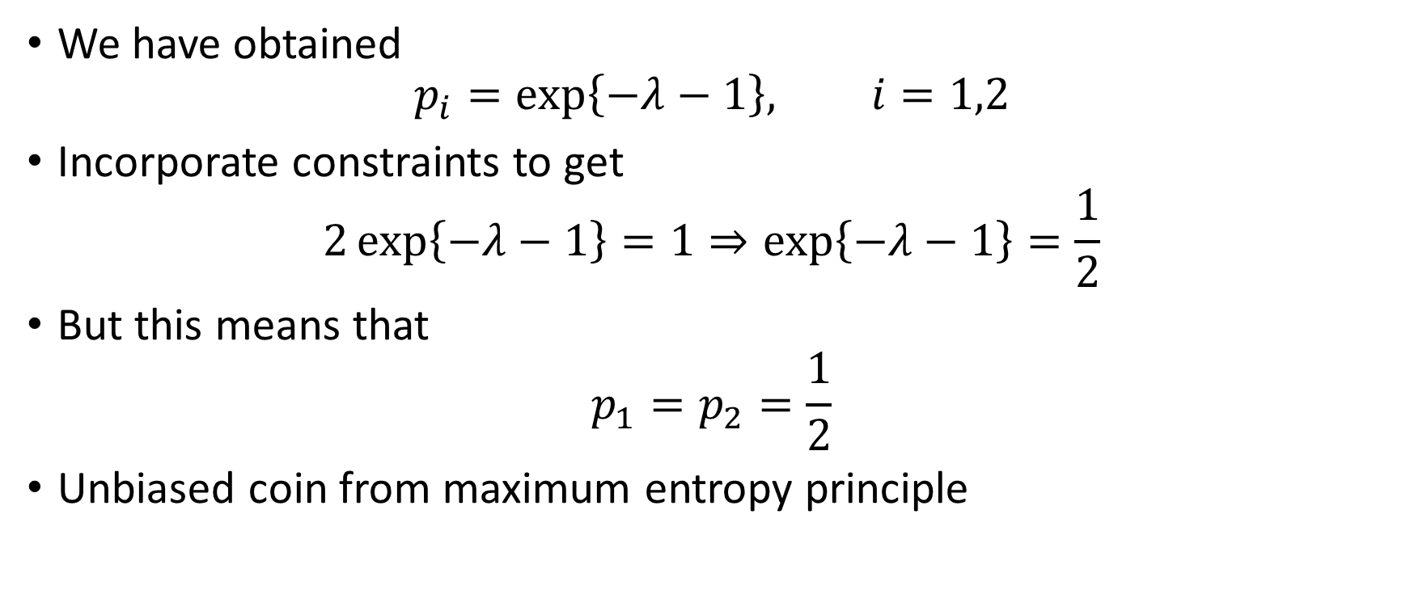
Maximizing the Entropy (contd.)
We have obtained
$$p_{i}=\exp\left\{−λ−1\right\}, i=1,2$$
Incorporate constraints to get
$$2\exp\left\{−λ−1\right\}=1⇒\exp\left\{−λ−1\right\}=\frac{1}{2}$$
But this means that
$$p_{1}=p_{2}=\frac{1}{2}$$
Unbiased coin from maximum entropy principle

Slide 6
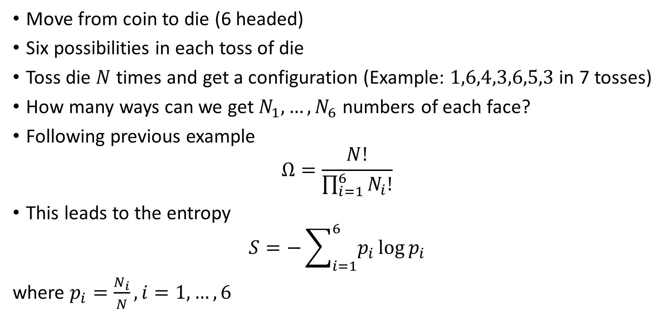
Extension
Move from coin to die (6 headed)
Six possibilities in each toss of die
Toss die $N$ times and get a configuration (Example: $1,6,4,3,6,5,3$ in 7 tosses)
How many ways can we get $N_{1},…,N_{6}$ numbers of each face?
Following previous example
$$Ω=\frac{N!}{\prod_{i=1}^{6}{N_{i}!}}$$
This leads to the entropy
$$S=−\sum_{i=1}^{6}{p_{i}}\log{p_{i}}$$
where $p_{i}=\frac{N_{i}}{N},i=1,…,6$

Slide 7
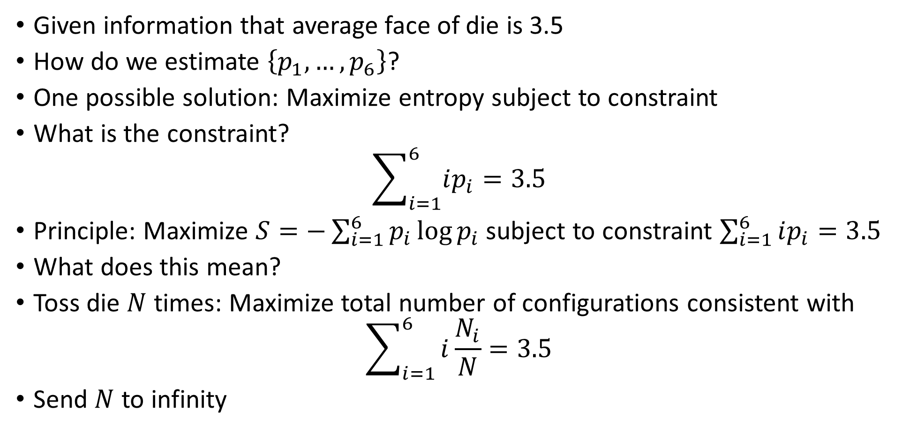
Macroscopic Constraints
Given information that average face of die is 3.5
How do we estimate $\left\{p_{1},…,p_{6}\right\}$?
One possible solution: Maximize entropy subject to constraint
What is the constraint?
$$\sum_{i=1}^{6}{ip_{i}=3.5}$$
Principle: Maximize $S=−\sum_{i=1}^{6}{p_{i}}\log{p_{i}}$ subject to constraint $\sum_{i=1}^{6}{ip_{i}=3.5}$
What does this mean?
Toss die $N$ times: Maximize total number of configurations consistent with
$$\sum_{i=1}^{6}{i\frac{N_{i}}{N}=3.5}$$
Send $N$ to infinity

Slide 8
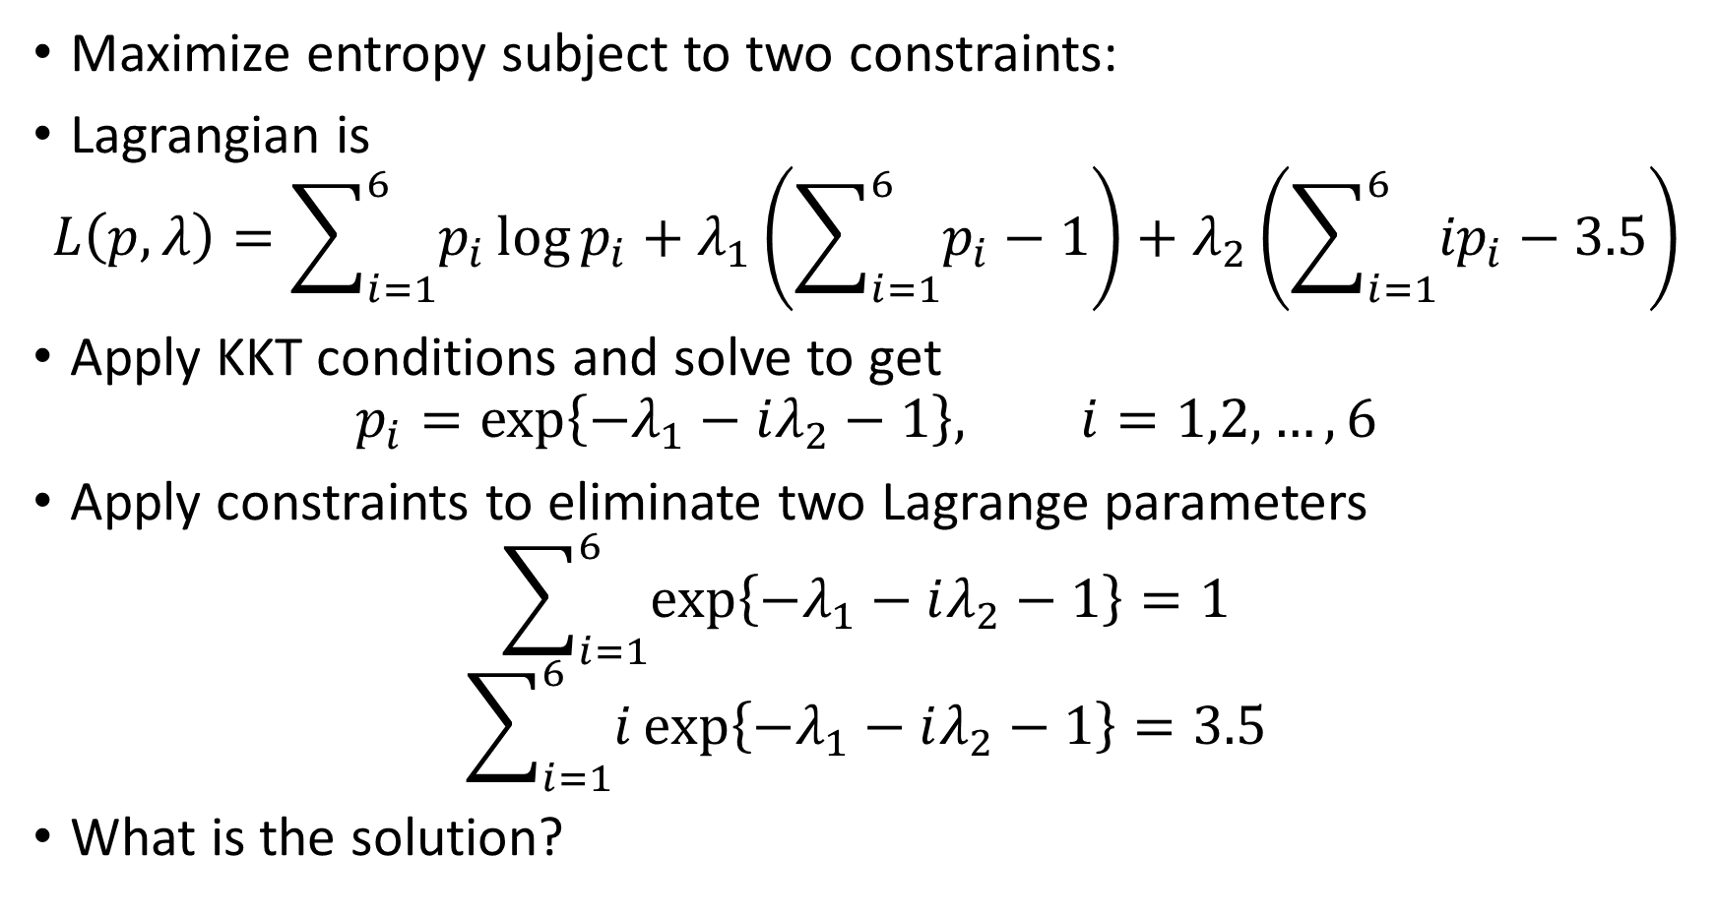
Lagrangian for Macroscopic Constraints
Maximize entropy subject to two constraints:
Lagrangian is
$$L\left(p,λ\right)=\sum_{i=1}^{6}{p_{i}}\log{p_{i}}+λ_{1}\left(\sum_{i=1}^{6}{p_{i}}−1\right)+λ_{2}\left(\sum_{i=1}^{6}{{ip}_{i}}−3.5\right)$$
Apply KKT conditions and solve to get
$$p_{i}=\exp\left\{−λ_{1}−iλ_{2}−1\right\}, i=1,2,…,6$$
Apply constraints to eliminate two Lagrange parameters
$$\sum_{i=1}^{6}{\exp\left\{−λ_{1}−iλ_{2}−1\right\}}=1$$
$$\sum_{i=1}^{6}{i\exp\left\{−λ_{1}−iλ_{2}−1\right\}}=3.5$$
What is the solution?

